Slide 1
Soft Systems Methodology
Presented by: Bohan Yang; Kaiyu Wang

Slide 2
In everyday life, we may face some problematical situations….
A university may fell that its student intake is too biased towards students from middle-class homes. What are the implications of changing that?
A local council may be receiving complaints that the delivery of its services is not sufficiently ‘citizen-friendly’. What should it do?
A head teacher may wonder how to decide whether to take on the responsibility for providing school meals or to leave that function to the local education authority.

Slide 3
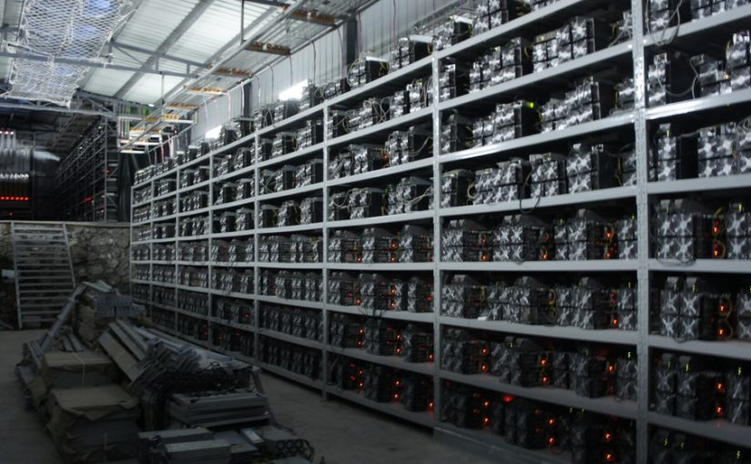
Bitcoin

Slide 4
Could be solved by…
Appealing to previous experience
Randomly thrashing about
Responding emotionally
Or
Could be addressed by using SSM

Slide 5
What is SSM?
SSM is Soft Systems Methodology, it is an action-oriented process of inquiry into problematical situations in the everyday world.
Users learn their way from finding out about the situation to defining/taking action to improve it.
The learning emerges via an organized process in which the real situation is explored, using as intellectual devices – which serve to provide structure to discussion – models of purposeful activity built to encapsulate pure, stated worldviews.
---Peter Checkland & John Poulter

Slide 6
What will we usually do to evaluate a system
Conduct a BPMN or UML to evaluate the system sequence
Conduct a DFD analysis to evaluate the data flow
Conduct a i* model to evaluate the dependency relationship among different actors.
Hard System Thinking

Slide 7
What will we usually do to evaluate an industry or a company ?
We will collect the data related to the industry
Conduct the analysis using the statistical models
Get a conclusion of the past and present performance, and give an estimation of the future operation.
Hard System Thinking

Slide 8
What is SE?
Systems Engineering (SE) is a process of naming a ‘system’, defining its objectives, and then using an array of techniques to ‘engineer’ the system to meet its objectives.
---Peter Checkland & John Poulter
However, it was too thin...not rich enough to deal with social complexity
Systems Engineering Soft Systems Methodology

Slide 10
What can SSM be used for?
Why widely used:
The SSM is a process of learning your way through problematical situations.
This learning is organized and structured by using models of purposeful activity. The sheer generality of purposeful action makes the application area so huge.
SSM can be used in…
Small/Large corporations; private/public sectors. Ex. National Health Service
SSM can also be used in information systems and information technology

Slide 11
SSM vs SE & others
SSM abandon the idea that the world is a set of systems.
The (social) world is taken to be very complex, problematical, mysterious, characterized by clashes of worldviews.
It is a methodology, not a method or way to solve problems.
There is no certain solution to a “problem”, however, there is an improvement on “problematical” situations.
A cycle of learning which goes from finding out about a problematical situation to defining/taking action to improve it
SE is an archetypal example of what is now known as ‘hard’ systems thinking.
Belief: the world contains interacting systems. They can be ‘engineered’ to achieve their objectives.
The belief also applies to other approaches.
Ex. the Viable System Model, the classic Operational Research…
Related problem could be solved within certain technical area
None of these approaches pay attention to the existence of conflicting worldviews.

Slide 12
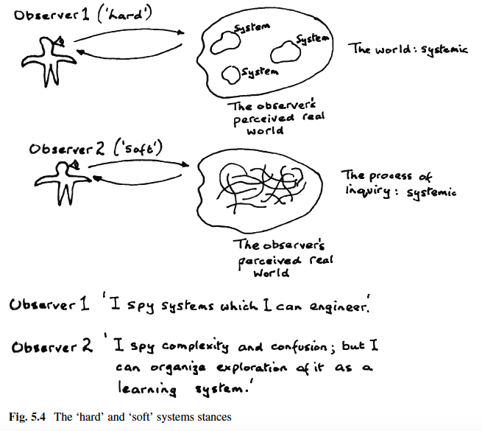
How the ‘soft’ systems see the world…

Slide 13
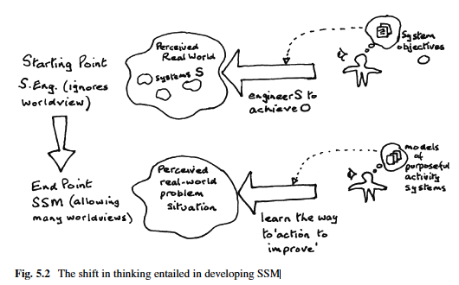
By introducing the term ‘worldviews’…

Slide 14
SSM

Slide 15
Soft System Methodology
1
The problem situation unstructured
2
The problem situation expressed
3
Root definitions of relevant systems
4
Develop conceptual models
5
Compare the conceptual model with the real world
6
If changes are arguably desirable and culturally feasible
7
Action to improve the problem situation

Slide 16
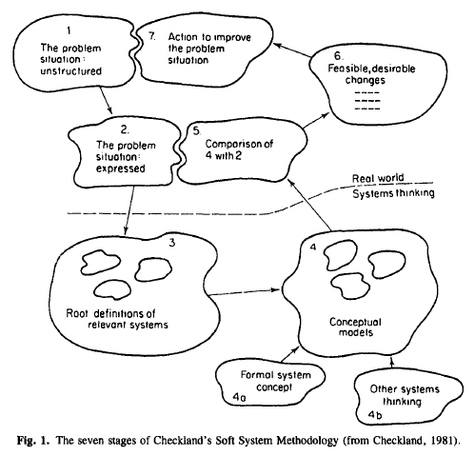
7 Stages of SSM

Slide 17
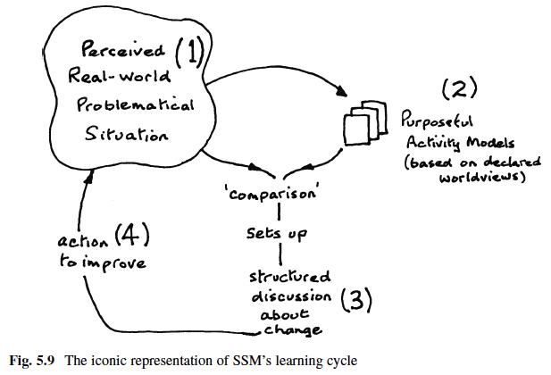
SSM learning cycle

Slide 18
The problem situation unstructured
The problem situation expressed
The first thing to express:
Why is a problem
It is recommend to use affinity diagrams

Slide 19
Rich picture vs. real-world problematical situation
The newly appointed head teacher of an 11s-to-18s school, which has overspent its budget in the last year or two, finds herself, in her first term, facing an issue concerning the provision of school meals. Currently these are provided by the county education authority through their catering services company, the contract being renewed annually. A member of that company who is leaving to set up her own catering company urges the head teacher to make a contract with her instead of the county, suggesting the school could save money on this. Some staff members agree with this, others want to stick with the status quo. Some parents, alerted by a national debate about school meals, want more nutritious meals as long as they don’t cost more. Pupils say: ‘We like burgers and chips.’ The school governors are discussing this issue; the Chairman, himself MD of a catering company, is urging the head teacher to be entrepreneurial and to take on responsibility for the provision of school meals, believing this could be profitable for the school.

Slide 20
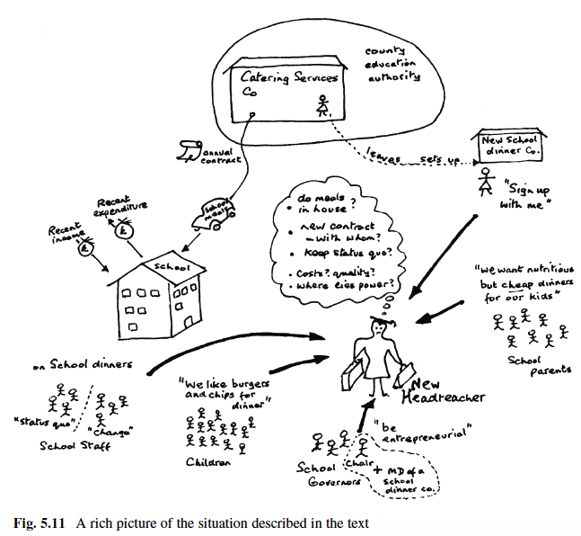
Rich picture Example

Slide 21
Rich picture
The complexity of human situations is always one of multiple interacting relationships. A picture is a good way to show relationships.
In making a Rich Picture the aim is to capture, informally, the main entities, structures and viewpoints in the situation, as well as the processes going on, the current and any potential issues

Slide 22
Rich picture
Structure
Process
Worries
Use the language of those in the problem
Use mostly figures, and little text
https://www.youtube.com/watch?v=39XSIzLuzKg

Slide 23
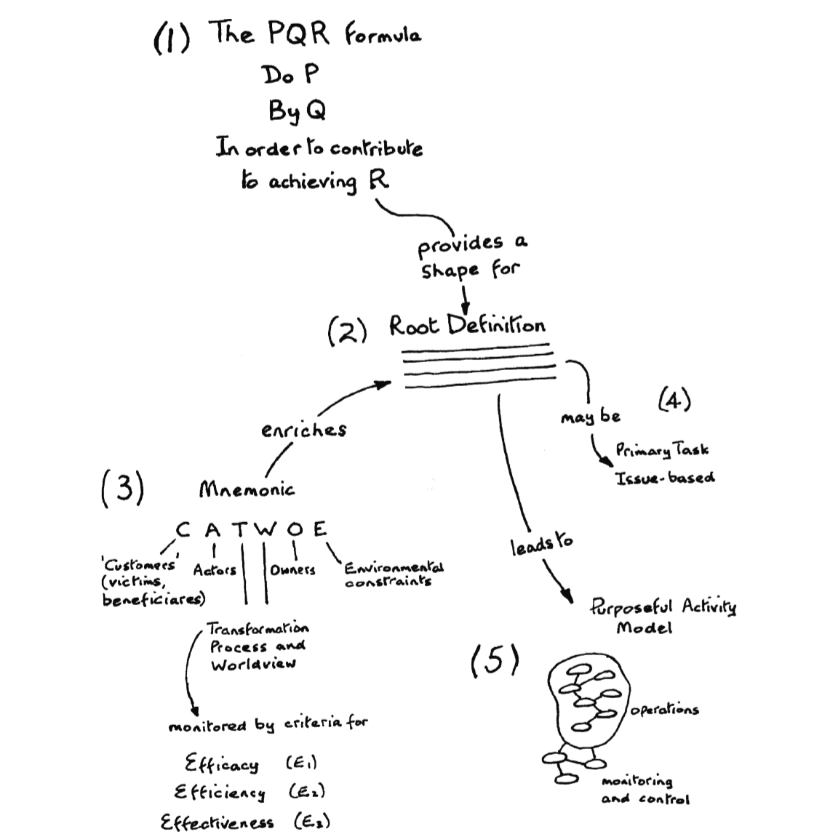
3. Root definition of relevant systems

Slide 24
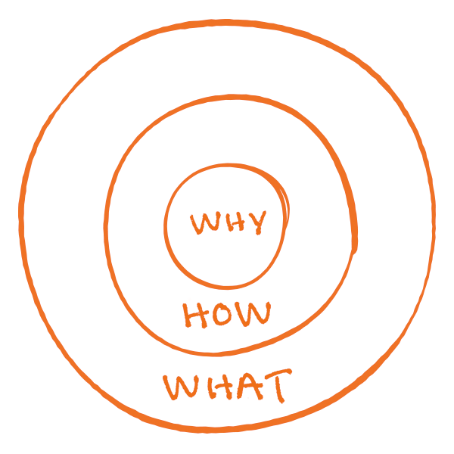
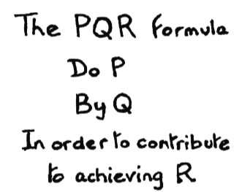
The PQR Formula

Slide 25
CATWOE
C: Clients [third step]
Who are the victims or beneficiaries of T
A: Actors [fourth step]
Who make T possible
T: Transformation process [first step]
The conversion of input and output
W: Weltanschauung (What is intended to achieve) [second step]
The worldview which makes T meaningful in a context
O: Owner [fifth step]
Those who have the power to stop or to change T.
E: Environmental constraints [sixth step]
Internal and External contraints

Slide 26
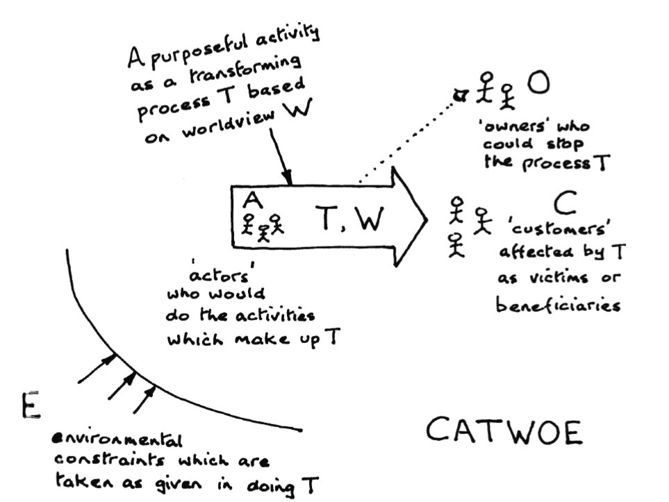

Slide 27
Root Definition
What is trying to Achieve W Weltanschauung
How? T Transformations
What constrains it? E Constraints
Horizon on Harbord Street
System that seeks to provide different types of gas to the customers, who lives near U of T or work at U of T in order to save their time; taking into account issues such as : demand budget, traffic situation, gasoline price, etc.

Slide 28
Let’s Play a Game

Slide 29
1. Problem
Kyrie, a first year international student in iSchool, was injured when playing basketball in the university’s division. Unfortunately, his ACL and meniscus has been torn. Even though most of the medical fee has been cover, he waited 2 months to get a MRI, and doctor said, he needs to wait for 4 months for surgery. In addition, he cannot get the best surgeon in Toronto area since the surgeon can only be referred by doctors.

Slide 30
How to improve health-care system in Canada fair ?
(Think from different perspectives)

Slide 31
1. Draw a Rich Picture

Slide 32
2. Conduct a root definition

Slide 33
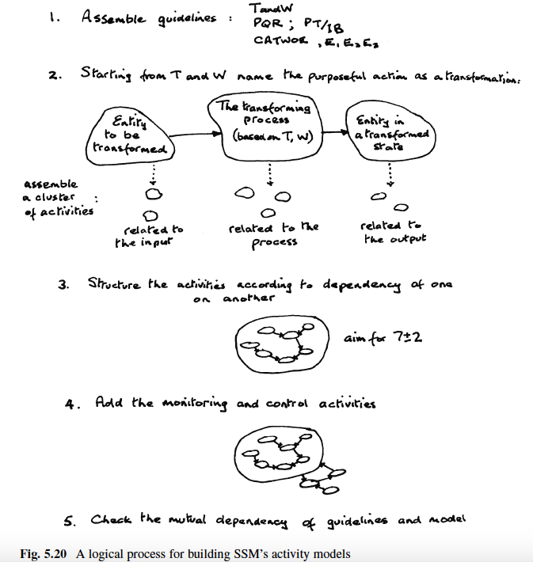
4. Develop conceptual models

Slide 34
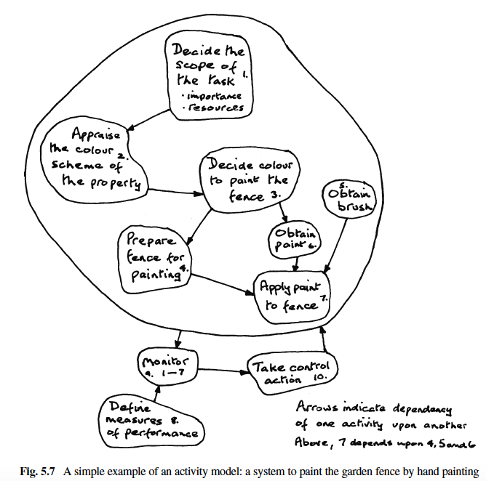

Slide 35
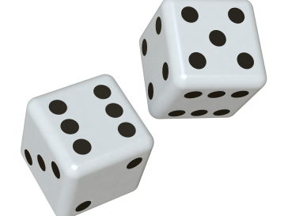
Back to Game

Slide 36
5. Compare the conceptual model with the real world
Remember: The models are the devices which enable that discussion to be a structured rather than a random one.
Models as a source of questions to ask about the situation.
Several ways:
Using flip charts on the wall (informal)
Create a chart matrix (formal)
Scenarios

Slide 37
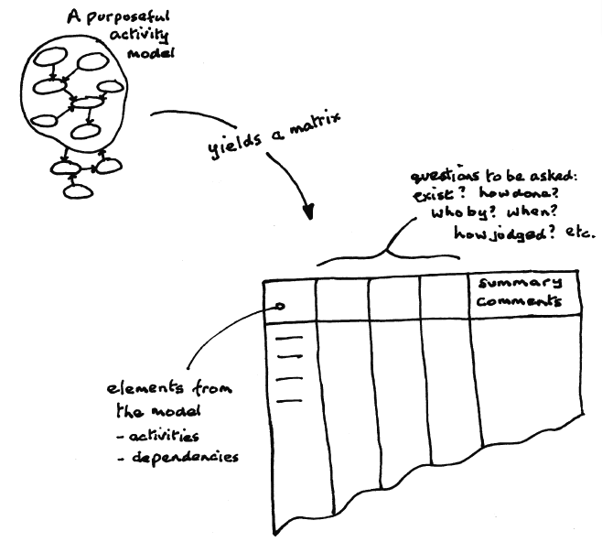
5. Compare the conceptual model with the real world

Slide 38
7. Action to improve the problem situation
Individuals have different genetic dispositions and experiences in the world.
It is better to find an accommodation. That is to say they will have to find a version of the situation which they can all live with.

Slide 39
In summary…
Seven Principles
1. The idea ‘real-world problem’ is subsumed in the broader concept of ‘real-world problematical situation’.
2. All thinking and talking about problematical situations will be conditioned by the worldviews of people doing the thinking and talking.
3. Every real-world problematical situation will contain people trying to act purposefully.
4. Discussion and debate about such a situation can be structured by using the models in (3) as a source of questions to ask about the situation.

Slide 40
In summary…
Seven Principles
5. Acting to improve a real-world situation entails finding, in the course of discussion in (4), accommodations among different world-views.
6. The inquiry created by principles above is a never-ending process of learning. New situation will be created!
7. Explicit organization of the process which embodies principles above enables conscious critical reflection about both the situation itself and also about the thinking about it

Slide 41
In summary…
Five Activities
1. Finding out about a problematical situation
2. Making models relevant to exploring it, based on different worldviews
3. Questioning the situation using the models (find desirable & feasible changes).
4. Taking action to change the situation in order to improve it.
5. Critical reflection on the whole process (from the 7th principle)

Slide 42
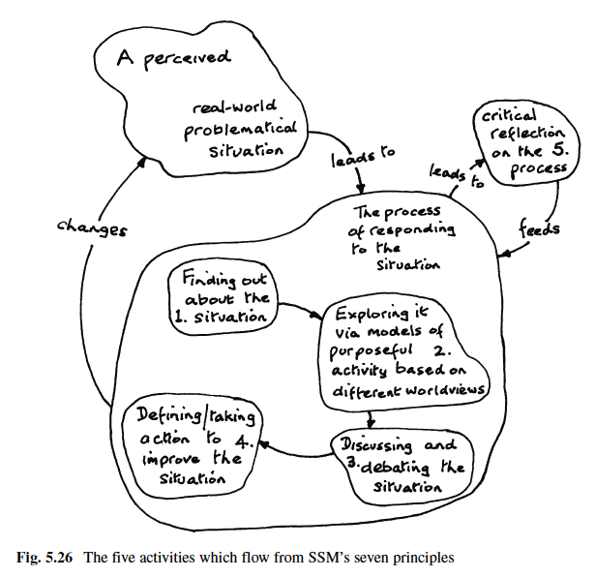
Five activities

Slide 43
Repeat some core Ideas..
It does not seek ‘solutions’ which ‘solve’ real-world problems.
In the real world, things will be more complicated.
SSM focuses on the process of engaging with that complexity.
It is an organized process of thinking that enable groups of people to learn their way to taking ‘action to improve’.
SSM is a methodology, not a method or a way to solve problems.

Slide 44
References
Checkland, P., & Poulter, J. (2010, January 08). Soft Systems Methodology. Retrieved January 23, 2018, from https://link.springer.com/chapter/10.1007%2F978-1-84882-809-4_5
Checkland, P. (1981). Systems Thinking, Systems Practice, Wiley, Chichester.
Kish, K., Bunch, M. J., & Xu, B. J. (2015, June 23). Soft Systems Methodologies in Action: Environment, Health & Shanghai’s Elderly. Retrieved January 23, 2018, from https://link.springer.com/article/10.1007%2Fs11213-015-9353-4
Sinn, J. S. (n.d.). A Comparison of Interactive Planning and Soft Systems Methodology: Enhancing the Complementarist Position. Retrieved January 23, 2018, from https://link.springer.com/article/10.1023%2FA%3A1023098025076

Slide 45
THANK YOU

