Slide 1
Generative Pattern Language
By Michal Telem and Karen Fingas
Karen Fingas and Michal Telem 2018

Slide 2
Agenda:
What is Generative Pattern Language?
Background: Christopher Alexander
Main Concepts and Qualities
Examples for implementations
Recommended Processes
Pros and Cons
Karen Fingas and Michal Telem 2018
Notes:
Karen Talks

Slide 3
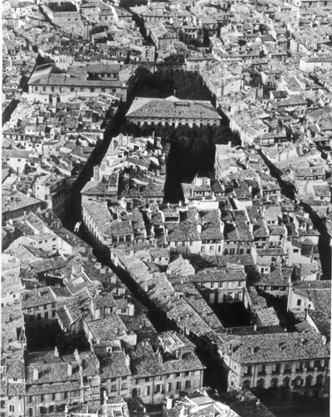
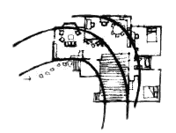
Christopher Alexander
Architect
Intimacy Gradient
Karen Fingas and Michal Telem 2018
Notes:
Karen Talks

Slide 4
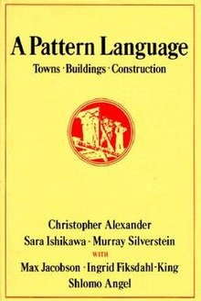
“The Pattern Language”, 1977
Alexander was looking for a way to approach design at all levels: from cities and towns to houses and rooms and even constructions techniques
In the 1970s, Alexander observed certain things that were seen repeatedly in the form of architectures and found that they are “patterns”
In his book “A Pattern Language - Towns, Buildings, Construction” Alexander released 253 patterns extracted from his and his colleagues’ knowledge.
http://www.patternlanguage.com/apl/aplsample/aplsample.htm
Karen Fingas and Michal Telem 2018
Notes:
Michal Talks

Slide 5
Main Concepts
At first:
Context - Problem - Solution
Whenever a certain CONTEXT exists, a certain PROBLEM will arise; the stated PATTERN will solve the PROBLEM and there should be provided in the CONTEXT.
Karen Fingas and Michal Telem 2018
Notes:
Michal
A service system can be defined as "a dynamic value-cocreation configuration of resources, including people, organizations, shared information (language, laws, measures, methods), and technology, all connected internally and externally to other service systems by value propositions"
Every service system is both a provider and client of service that is connected by value propositions in value chains, value networks, or value-creating system …

Slide 6
Later: Context - System of Forces - Configuration
Each Pattern is a rule which establishes a relationship between a context, a system of forces which arises in that context, and a configuration which allows those forces to resolve themselves in the context.
Karen Fingas and Michal Telem 2018
Notes:
Michal

Slide 7
Currently: Process oriented towards service systems
(i) voices on issues (who + what)
(ii) affording value(s) (how + why), and
(iii) spatio-temporal frames (where + when)
David Ing “Pattern Manual for Service Systems Thinking”.
Karen Fingas and Michal Telem 2018
Notes:
Karen

Slide 8
Currently: Process oriented towards service systems
1 Pattern Label | Signing in for services
2 Voices on issues(who/what) | a) For a client, what services are available to me, now and on appointment? (b) For a parent, what do I do with my kids while I‘m busy? c) For a child, what can I do while my parent is at the Multi Service Centre?
3 Affording values(how/why) | Matching client needs with MSC resources, so that holistic treatments are received. Triaging and scheduling so that urgent cases are prioritized, and wait times are tolerable
Karen Fingas and Michal Telem 2018
Notes:
Karen
This is an example of a Multi
Service Centre operation

Slide 9
Currently: Process oriented towards service systems
4 Spatio-temporal frames(where/when) | On demand lookups of trending and prior MSC busy and slow periods transparently visible onsite and on the Internet, enabling clients to adjust and/or rebook
5 Containing Systems(slower/larger) | For municipal, regional and national agencies, are community health and social services in their jurisdictions well provided?
6 Contained Systems(faster/smaller) | For friends or assistants speaking on behalf or interpreting for a client, is the situation understood?
Karen Fingas and Michal Telem 2018
Notes:
Karen

Slide 10
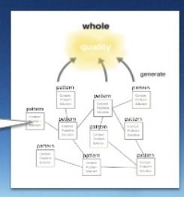
Generative
It not only tells us the rules of arrangement, but shows us how to construct as many arrangements we want which satisfy the rules.
http://www.patternlanguage.com/apl/aplsample/aplsample.htm
Karen Fingas and Michal Telem 2018
Notes:
Michal

Slide 11
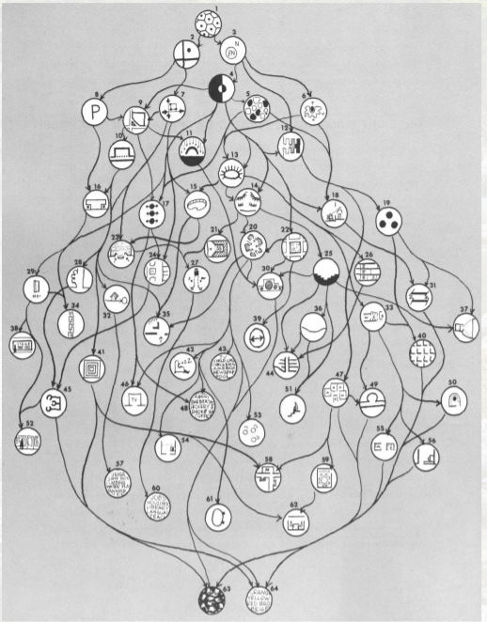
Many Patterns form a language
Karen Fingas and Michal Telem 2018
Notes:
Karen

Slide 12
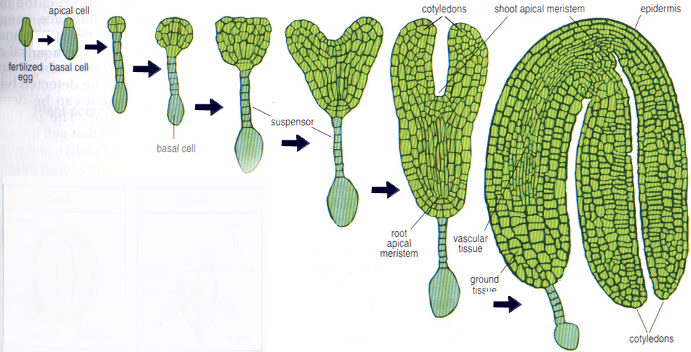
Unfolding - The key element of any generative code
Karen Fingas and Michal Telem 2018
Notes:
Karen Talking

Slide 13
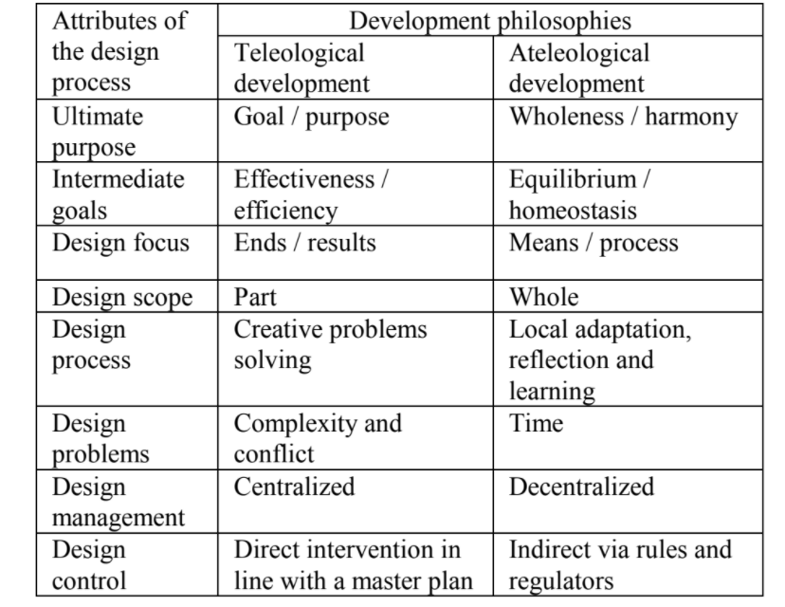
Qualities:
David Ing “From Environmental Structure to Service Systems Thinking: Wholeness with Centers Described with a Generative Pattern Language.” .
Karen Fingas and Michal Telem 2018
Notes:
Michal Talking

Slide 14
Proposed procedures for making a pattern Language
Pattern Mining
Pattern Prototyping
Pattern Writing
4. Pattern Organizing
5. Catalog Editing
Karen Fingas and Michal Telem 2018
Notes:
Karen Talking

Slide 15
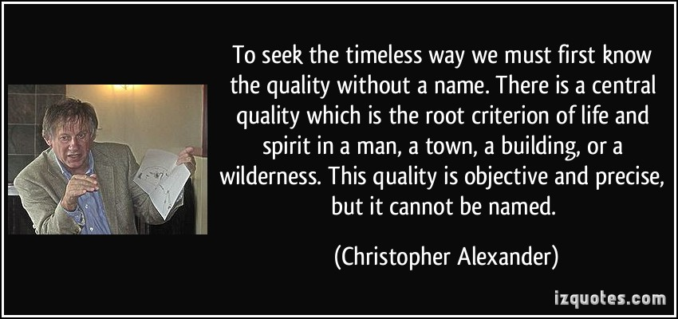
The quality without a name: Objectivity
Karen Fingas and Michal Telem 2018
Notes:
Michal/Karen
ROM - Crystal example?

Slide 16
Examples:
Build environment - http://www.livingneighborhoods.org/ht-0/archive.htm
Software development - Agile
Wiki - http://wiki.c2.com/?WikiWikiWeb
Service Systems - An Alexandrian format and pattern for Multi Service Centers
A Pattern Language for Systemic Transformation (PLAST) - “You cannot understand a system until you try to change it” said Kurt Lewin https://www.academia.edu/9138366/A_Pattern_LAnguage_for_Systemic_Transformation_PLAST_-_re_Generative_of_Commons
Karen Fingas and Michal Telem 2018

Slide 17
Generative Pattern Language - Pros:
Flexible and versatile Methodology
Great tool to combine hard system thinking and soft systems thinking
Gives the opportunity to pay full respect to unique features of a system
Ease of use - Provides sequence of actions - order and Tells us which patterns “go together”
Karen Fingas and Michal Telem 2018
Notes:
Michal

Slide 18
Generative Pattern Language - Cons
Relies on collaboration - not everyone can/will participate
Patterns take labour and time to develop
Need experts
Karen Fingas and Michal Telem 2018
Notes:
Karen

Slide 19
“A generative code is a system of unfolding steps that enable people in a community to create...”
- Christopher Alexander
Karen Fingas and Michal Telem 2018
Notes:
Takeaways from GPL

Slide 20
References
Karen Fingas and Michal Telem 2018
Alexander, Christopher. “Generative Codes.” Living Neighbourhoods. Accessed February 1, 2018. http://www.livingneighborhoods.org/ht-0/generative.htm.
Ing, David. “Pattern Manual For Service Systems Thinking,” October 28, 2016. http://coevolving.com/pubs/20161028_PUARL_Ing_PatternManualForServiceSystemsThinking_v1020a.pdf.
Ing, David.. An Introduction to Service Systems Thinking (Part 2 of 2) 2015/10/02. Accessed January 27, 2018. https://www.youtube.com/watch?v=j3a4j9xN61I.
Iba, Takashi, Mami Sakamoto, and Toko Miyake. “How to Write Tacit Knowledge as a Pattern Language: Media Design for Spontaneous and Collaborative Communities.” Procedia - Social and Behavioral Sciences, The 2nd Collaborative Innovation Networks Conference - COINs2010, 26 (January 1, 2011): 46–54. https://doi.org/10.1016/j.sbspro.2011.10.561.
Gabriel, Richard P. 1996. “The Quality Without a Name.” In Patterns of Software, 33–44. New York: Oxford University Press.
http://dreamsongs.net/Files/PatternsOfSoftware.pdf.
Iba, Takashi, “Peer Learning via Dialogue with a Pattern Language”, in the 7th International Conference on Collaborative Innovation Networks (COINs17), Detroit, USA, Sep., 2017.
https://www.slideshare.net/takashiiba/peer-learning-via-dialogue-with-a-pattern-language
Chihyang Li, “A brief introduction about design patterns in Swift language”, 2017.
https://www.slideshare.net/ChihyangLi/design-patterns-in-swift-ch0-introduction
https://blog.p2pfoundation.net/what-is-an-unfolding/2015/04/12 https://www.slideshare.net/ChihyangLi?utm_campaign=profiletracking&utm_medium=sssite&utm_source=ssslideview

