Slide 1
DIALOGUE, ENGAGEMENT & INTERVENTION
Caroline Mellberg, Wang Yuchan, Jukka-Pekka Ovaska, Ida-Maria Mannonen

Slide 2
CONTENT
Hard systems thinking
Soft systems thinking
Dialogue
Exercise
Methodologies of intervention
Evolutionary
Diamond schematic
Soft system method
Conclusion

Slide 3
There have been several phases in the systems movement
Today we will discuss two major phases:
1. Hard (first-order) systems thinking
2. Soft (second-order) systems thinking

Slide 4
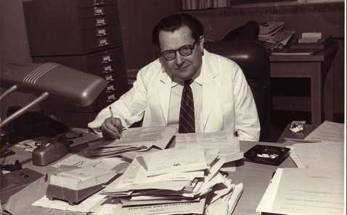
General Systems Theory (GST)
Developed by biologists and economists in the 50s and 60s
Main concepts:
Open and closed systems
Homeostasis
Important figures:
Ludwig von Bertalanffy
Kenneth Boulding

Slide 5
Cybernetics
Developed by engineers
Main concepts: goal-directed systems, control-mechanisms
Important figures: Ross Ashby, Norbert Wiener, Stafford Beer

Slide 6
System Dynamics
Mathematical models about how systems change over time
Stock-and-flow models, positive and negative feedback models
Important figures: Jay Forrester, Donella Meadows
Source: Stacey (2010).

Slide 7
Main assumption:
The world is systemic. We can control and understand systems by using mathematical models
Other assumptions:
System objectively exist in our world and it has a good structure and an identifiable goal
The parts of the system have the same worldviews, values and interests
The system intervener is an outsider of system and is not influenced by the system
Achieving the optimal results is the ultimate goal of problem-solving
Source: Zexian & Xuhui (2010)

Slide 8
Soft systems methodolody
soft=people
systems=can apply the theory of systems
methodology=organized way of thinking
SSM is all about people and the way wen think and relate to one another

Slide 9
In SSM
a loose framework of tools to be used at the discretion of the analyst, focusing on improvements to organisational problems.

Slide 10
Soft systems thinking
“People oriented”
“relationship seeking”
SST is represented through the use of “Rich pictures”

Slide 11
Rich picture
iconic representations - drawn together into a picture which sums up the important elements of the problem situation

Slide 12
Key values of SST
Critiques of SSM
give stuctures
provides better fit between systems and people
facilitates resolution of unsolved problems and issues
----SST is to explain why the problem is a problem
SSM does not actually tell you how to build a system
Assumes that all actors in a problem situation are equal
Rationlistic and idealistic

Slide 13
Difference HST vs SST
Difference HST vs SST
Difference HST vs SST
HST:
hard systems approaches (systems analysis (structured methods), systems engineering, operations research) assume:
objective reality of systems in the world
well-defined problem to be solved
technical factors foremost
scientific approach to problem-solving
one correct solution
SST:
soft systems approaches (Soft Systems Methodology, soft OR) assume:
organisational problems are ‘messy’ (Ackoff), poorly defined
stakeholders interpret problems differently (no objective reality)
human factors important
creative, intuitive approach to problem-solving
outcomes are learning, better understanding, rather than a ‘solution’
HSM:
assums the system already exists
goal oriented
SSM:
tackles real world problems
goal understanding

Slide 14
DIALOGUE
Notes:
Designing human systems is inherently problematic (an agreement in the systems thinking discipline)
Banathy - CONVERSATION AND DIALOGUE AS APPROACHES TO SOCIAL SYSTEM DESIGN
Allen, et al., (2003) propose that by making distinctions in biological systems we may get help in clarifying some of the problems that we come across when we move towards a better understanding of human social systems.
→ Engineering, as applied to ecological systems, may help us better understand design as applied to social systems.
We now go into these distinctions and through them go to the definitions of generative and strategic dialogue

Slide 15
Use of biological material as machines or incorporated into them
Branch of civil and sometimes industrial engineering
Standard engineering protocol
Horse-drawn equipment, using yeast in making beer or cheese etc.
ENVIRONMENTAL ENGINEERING
Notes:
The theory proposes environmental engineering as a process of design and production of machines driven by human purpose
Note the similarity with the concept of MECHANISTIC HUMAN ORGANIZATIONS
Burns & Stalker (1961) in The Management of Innovation → clear, vertical hierarchies of authority and control → efficiency, predictability through specialization, standardization and formalization → appropriate in stable environments & for routine tasks and technologies
Standard engineering protocol = it imposes an external design on material that is the passive recipient of engineered limits. Not so for ecological engineers, whose engineered material offers no such constancy.

Slide 16
ECOLOGICAL ENGINEERING
Doesn’t deal with controlled environments
Has no predictability of interactions and evolutions
Deals with processes of autopoiesis and self-organization
Notes:
(ii) the processes of autopoiesis (self-definition) and self-organization are typical of life and ecological systems
Koestler (1967) - Associative context = the context in which a process may occur or a structure may exist. The context may make the engineered function relevant/useful.
Ecological engineering deals with structures whose realization process and structured functionality is disrupted by failure of the associative context such that the original goals must be revisited

Slide 17
WHY THE SHIFT FROM ENVIRONMENTAL TO ECOLOGICAL?
Attempts of engineering environments lead to sets of assumptions
Pre-determined environments are typical to artificial, virtual or theoretical systems
Only certain possibilities exist, and change will not happen to the system
To what degree can autopoietic systems be consciously engineered?
Notes:
Explicit goals:
FIX THE INTENDED OUTCOME
CREATE A CLOSED SYSTEM in which the design and implementation are to take place
Assume a HIGH DEGREE OF STABILITY IN THE ENVIRONMENT, without which no plan can be expected to create a predictable outcome.
Biological ecosystems are comprised of the organisms within them, but not in the same way that organisms are made up of cells.

Slide 18
“We do not expect the properties of cells to express the full functioning of organs or organisms.
And yet we continue to deal with human societies through sciences developed for physics, or possibly biology at best”
Notes:
But organisms have a more tangible structure than ecological systems.

Slide 19
Luhmann (1995, p.11) Social systems as autopoietic systems
Elements that make up the system have no duration
Elements are constantly produced by the system they comprise
The elements are equipped with capacity for meaning
Allen et al. (2003)
Ecological systems as autopoietic systems
An ecosystem is not a realized structure like an organism is
An ecosystem is a becoming, not a being
AUTOPOIETIC SYSTEMS
Notes:
If we look at the qualities of autopoietic systems, they’re hard to imagine being manageable by mechanic procedures or engineering
Allen, et al. also refer to ecological systems as autopoietic systems, in much the same way that Luhmann (1995) referred to social systems.
The theory of self-producing, autopoietic systems can be transferred to the domain of action systems only if one begins with the fact that the elements composing the system have no duration, and thus must be constantly produced by the system these elements comprise... The system would simply cease to exist in any, even the most favorable, environment if it did not equip the momentary elements that compose it with the capacity for connection, that is, with meaning, and thus reproduce them (Luhmann, 1995, p. 11)
Because of all this, Banathy (1996) has suggested dialogue and conversation as means of social systems design -

Slide 20
LANGUAGE
Different social systems have different contexts for different types of conversation
Identifying with a system in your own and others’ experience means learning how to engage in the interaction that is unique to the specific system
Language could be seen as a fabric of social systems
Notes:
Dealing with language, as such, though, is highly complex and extremely difficult. We obviously need language, but it is often anything other than clear or exact, which is why relying on mathematics is much cleaner. Planning needs language

Slide 21
SOCIAL SYSTEMS DESIGN

Slide 22
GENERATIVE DIALOGUE
Doesn’t have an agenda, acts on the environment of strategic dialogue
Not trying to reach a useful goal
Leads to collective consciousness, focus on the thoughts, values and worldviews in the group
Creates a flow of shared meaning and perceptions, even worldview – and a social milieu of friendship and fellowship
Notes:
Because direct parallels between ecological and social systems could be dangerous, since we’re not sure if they’re completely analogous, they should of course be treated as metaphorical - useful for discussion, but not necessarily for research.
As described by Banathy (1996), generative dialogue is not meant to replace strategic dialogue, but to precede it (see Metcalf, 2008).
→ Acts on the environment in which strategic dialogue is to take place
opens possibilities by creating a deeper sense of understanding
creates new connections between ideas or ways of thinking
creates a sense of trust which makes the sharing of ideas feel less threatening that it might otherwise.
SHARED COMMITMENT
In a world focused on short-term efficiency and optimization, generative dialogue may appear extravagant, wasteful, or even pointless. The critiques, though, rarely go back to calculate the waste produced by ineffective short-term efforts that miss targets or goals entirely.

Slide 23
STRATEGIC DIALOGUE
There are fixed, agreed ends in mind for the dialogue
The appropriate limitations and “closure of the information space” are being determined by the decisions of the planners
External design can be imposed on a passive recipient of engineered limits
Notes:
We oversimplify ecological or social systems when trying to affect them.
Strategic dialogue alone can, of course, produce results. These often happen quicker, at less short-term expense, and with less involvement by stakeholders
Because the world is both more dispersed, and at the same time connected, the need for generative dialogue (or some alternative that creates a similar result) is critical. THERE IS VERY LITTLE LEFT IN OUR HUMAN WORLD THAT REMAINS IN ISOLATION.
We may be a long way from fully understanding human social systems as such, but LEARNING TO MAKE DISTINCTIONS BETWEEN MECHANISTIC AND ECOLOGICAL SYSTEMS, EVEN AT THE BIOLOGICAL LEVEL, IS A STEP IN THE RIGHT DIRECTION.

Slide 24
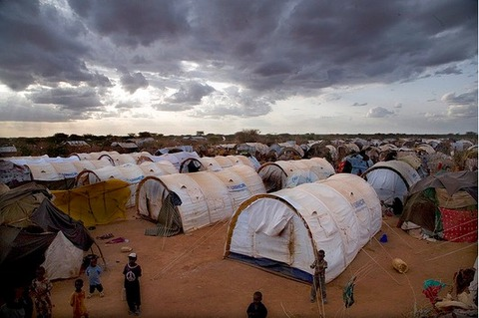
DIALOGUE WORKSHOPS
Refugee
Agenda: You want to find a new safe place to stay and find a way to reunite your family
2. Prime minister of a European country
Agenda: Your primary motivation is to try to balance limited resources, political pressures and the surge of refugees to your country.
3. Citizen of a European country
Agenda: You are worried for your family’s livelihood. You want to make sure that you don’t end up less off from the situation.
4. NGO
Agenda: You want to make sure those in most need receive help. You are worried especially about the thousands of refugee children that are alone in Europe.
5 minutes of free discussion and preparations per each stakeholder group together
Arranging into groups where there are participants from all the 4 stakeholder groups
15 minutes of dialogue
Generative dialogue – establishing common ground, sharing positive motivations, focus on discussing worldviews and values, not trying to reach a goal!
Strategic dialogue – Trying to reach an established outcome for solving a refugee-related problem – e.g. finding employment, housing, family integration etc.

Slide 25
Methodologies of intervention and design
^{Evolutionary system design}
^{The diamond schematic}
^{Soft system methodology}
Notes:
Methodology of discourse help people clarify their assumptions, develop alternative views and synthesize them.
Therefor I will now mention three different methodologies which all encourage intervention and design.
^{The three are:}

Slide 26
Evolutionary system design
“To address the demands of the emerging fourth generation we ^{must} ^{change our awareness so we are} conscious of our role in the evolution and can take a critical stand in the current
^{system of public discourse”}
http://www.bobwilliams.co.nz/Systems_Resources_files/ssm.pdf
Notes:
The method of evolutionary system design was invented by Dr. Bela H. Banathy and he describes the methodology like this:
“To address the demands of the emerging fourth generation we must change our awareness so we are conscious of our role in the evolution and can take a critical stand in the current system of public discourse”

Slide 27
Evolutionary system design
How do we move on to the fourth generation based on the knowledge of our societal evolution?
Notes:
So basically it says: how do we move on to the fourth generation based on the knowledge of our societal evolution?

Slide 28
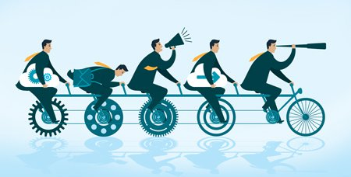
Evolutionary system design: Method
Basics:
Create a team which are part of your desired future
NO experts
Individual contributions is important
Agenda free meetings
Basic agreements
http://www.bobwilliams.co.nz/Systems_Resources_files/ssm.pdf
Notes:
So first of all you create a team which are all a part of the desired future, NO experts allowed. Everyone is called on to make individual contributions. The meetings should be agenda free and you should start by putting up basic agreements such as intention, commitment and values.

Slide 29
Evolutionary system design: Method
Generative dialogue
Strategic dialogue
http://www.bobwilliams.co.nz/Systems_Resources_files/ssm.pdf
Notes:
First you start your dialogue in a generative way to seek common ground and shared values, then move on to a more strategic one; how will you achieve this?

Slide 30
Evolutionary system design: Method
^{*Formulate} ^{purposes} ^{What is it about? Why is} ^{it important?}
^{* Select functions} ^{What functions are} ^{needed to carry out the goals?}
* ^{Specify the components} ^{What real-world} entities must be established to put the functions ^{into effect?}
^{* Design the environment} ^{What external structures} and arrangements are needed to support ^{the intended system?}
^{* Model the system.} ^{What is the model of the} system? How can it be represented as ^{organized knowledge?}
http://www.bobwilliams.co.nz/Systems_Resources_files/ssm.pdf
Notes:
To prevent the group from becoming stagnated in endless conversation they can follow these topics: formulating purposes, select functions, specify components, design the environment and model the system

Slide 31
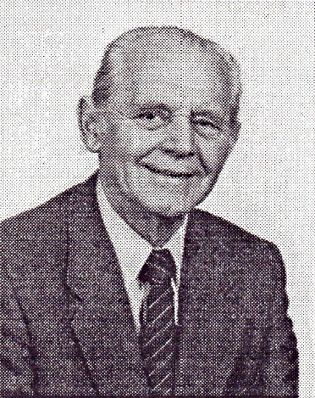
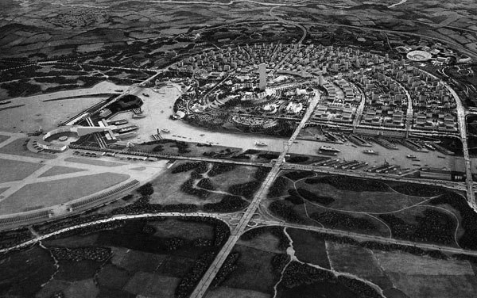
Evolutionary system design
^{‘The task is absolutely} not to propose a particular evolutionary future, but rather a possible approach to creating our ^{evolutionary future’}
^{(Banathy, 2000, p. 293)}
http://www.bobwilliams.co.nz/Systems_Resources_files/ssm.pdf
Notes:
Banathy himself says: The task is absolutely not to propose a particular evolutionary future, but rather a possible approach to creating our evolutionary future

Slide 32
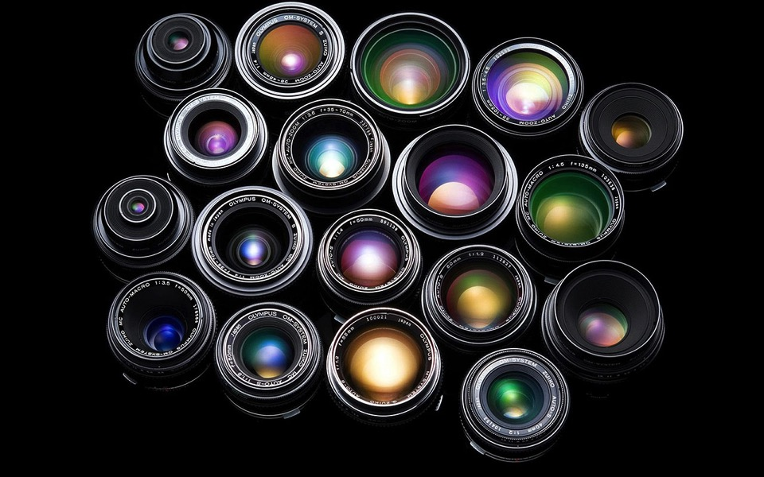
Evolutionary system design
Knowledge base - Available for all
Description of shared values
Statement describing the ideal future image
Models of proposed systems
Descriptions of all aspect of the proposed system
Lenses
System - environment
Function - structure
Process - behavioural
http://www.bobwilliams.co.nz/Systems_Resources_files/ssm.pdf
Notes:
Banathy was also a frontrunner in the idea of a shared knowledge base and he also proposed three lenses that could be attached on the model to shift its perspectives, since one model can’t fully respect a whole system

Slide 33
Evolutionary system design
Linkage agora
Local agora + steward
Local agora + steward
Local agora + steward
Local agora + steward
Local agora + steward
http://www.bobwilliams.co.nz/Systems_Resources_files/ssm.pdf
Notes:
Banathy wants to call the small groups of people for agoras and have an idea of that every agora should have a steward that knows the methodology and all the agoras should also be connected through internet on a so called linkage agora where all groups in the world can share ideas and processes

Slide 34
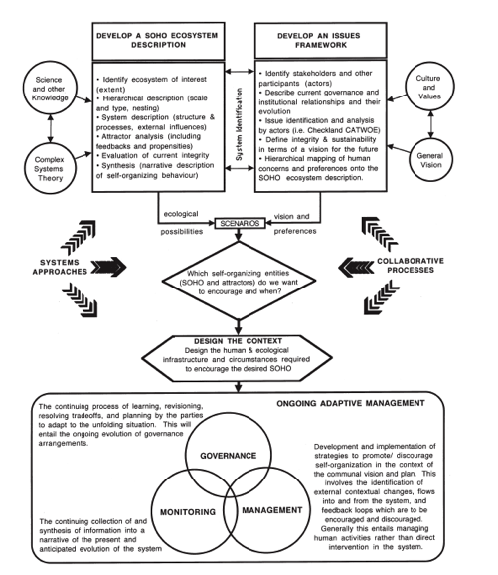
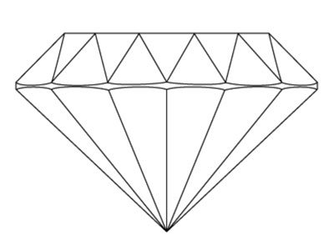
Diamond Schematic Method
How can we plan a future where human and natural ecosystems co-evolve?
The Evolution of an Ecosystem Approach: the Diamond ^{Schematic and an}
Adaptive Methodology for Ecosystem ^{Sustainability and Health} David Waltner-Toews1 and James Kay
Notes:
Second methodology is the Diamon Schematic method invented by James Key in 1994. His methodology answers to the question; How can we plan a future where human and natural ecosystems coevolve?
To visualize this he draw this scheme. The word diamond comes from the diamond in the middle where all stakeholders meet. To explain it for you I will break it down in to smaller parts.

Slide 35
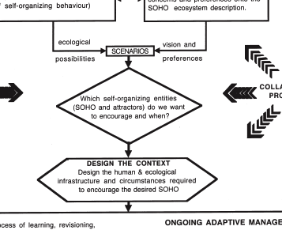
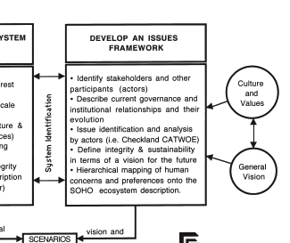
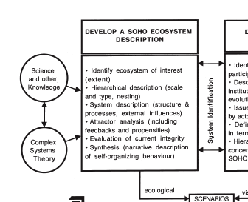
Environmental management
Diamond Schematic Method
Eco social system
Meet species needs
Preserve integrity of ecosystem
Nature itself has no preferences
People: This is how we want to see the people and nature coevolve
Scientist: This is how the future of ecosystem might look like
Policy makers and managers
The Evolution of an Ecosystem Approach: the Diamond ^{Schematic and an}
Adaptive Methodology for Ecosystem ^{Sustainability and Health} David Waltner-Toews1 and James Kay
Notes:
So first of all he have divided the eco social system in one box and Environmental management in another.
So here in the top left box is the scientists; instead of providing predictive statements for policymakers they are now providing decisions makers and the community with an appreciation of how the future might unfold through narrative descriptions.
In the top right box is the people, stakeholders and other participants that describes the landscape they would like to see in terms of human concerns and preferences.
The Diamond in the middle is a place where the ecological understanding and the sociocultural preferences meet and interface with policy makers and managers.

Slide 36
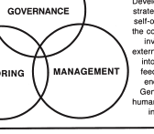
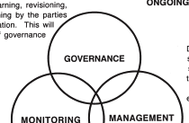
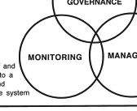
Diamond Schematic Method
Translate vision into reality
Observe result and create a narrative for governance and future management
- Process of learning
- Re-visioning
- Planning
The Evolution of an Ecosystem Approach: the Diamond ^{Schematic and an}
Adaptive Methodology for Ecosystem ^{Sustainability and Health} David Waltner-Toews1 and James Kay
Notes:
This methodology then gives a plan for the following three:
Governance, which involves the continuing process of learning, re-visioning and planning by the parties to adapt to the unfolding situation
Management which translates the vision into reality
And Monitoring which is the activity to observe the result of the human and natural systems and synthesizing those observation into a narrative as a baseis for governance and future management.
Taken together the framework of issues and the conceptual model provide the focus for the discussion of sustainability

Slide 37
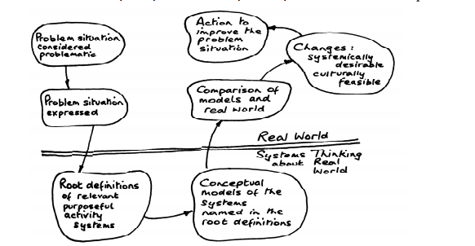
Soft system method
http://www.bobwilliams.co.nz/Systems_Resources_files/ssm.pdf
Notes:
So now I will describe the last one of the three; soft system method invented by Peter Checkland. When you follow this method you first break down your problem, take it from real life and put it in a system context. There you analyze it in smaller pieces and with different perspectives then you form a model with the pieces and bring it back to the real world again for evaluation.
I will describe this methodology by using an example of something called sustainable food collaboration. The primary activity of this collaboration is developing and sustaining a method of “Sustainable Food” labeling on foodstuffs.

Slide 38
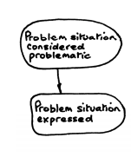
Soft system method
businesses that support environmentally sustainable products
sustainable food production in general
1.
Enter the problem/issue/situation
“Sustainable food collaboration”
Auditing fees
Labelling on foodstuffs
http://www.bobwilliams.co.nz/Systems_Resources_files/ssm.pdf
Notes:
So first step is to enter the problem and gather all necessary information around the issue. Don’t try to define the problem.
The sustainable food collaboration is for instance interested in the area of labeling food and auditing fees, but can also go broader and look into sustainable food production in general and other businesses in this area.

Slide 39
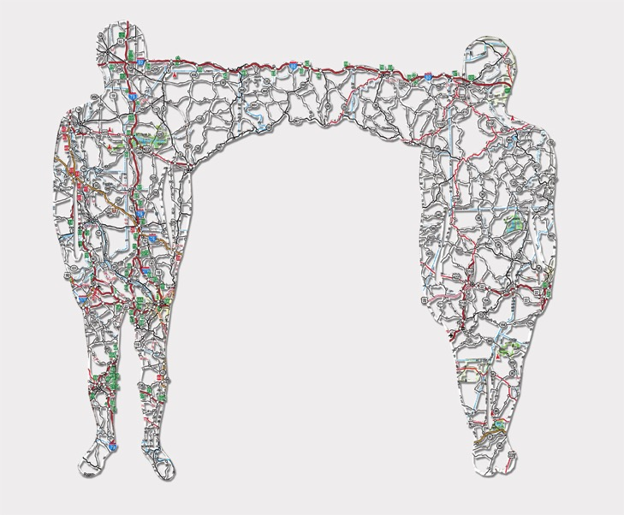
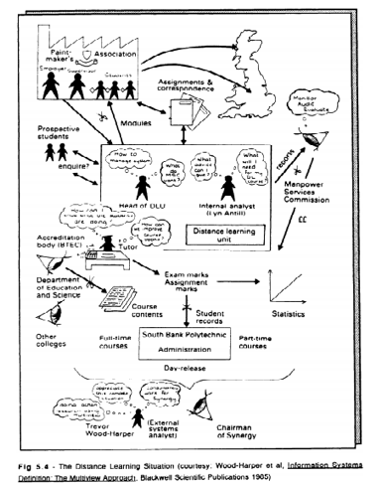
Soft system method
2.
Express the issue in a RICH picture
Consider:
Structures
Processes
Climate
People
Issues expressed by people
Conflicts
http://www.bobwilliams.co.nz/Systems_Resources_files/ssm.pdf
Notes:
Step number two is to now to define and express the issue in a RICH picture by considering: structures, processes, climate, people, issues expressed by people and conflicts. It is suggested to do this is picture form. This is an example how the issue of distance learning situation could look like.

Slide 40
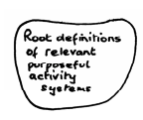
Soft system method
(start with transformation)
Customers who (or what) benefits from this transformation
Actors who facilitates the transformation to these customers
Transformation from “start” to “finish”
Weltanschauung view what gives the transformation some meaning
Owner to whom the “system” is answerable and/or could cause it not to exist
Environment that influences but does not control the system
3.
Root definitions of relevant systems
Go from real world into system world !
Divide the problem into Holons (separate value base by which to evaluate the situation)
Holon : separate value base by which to evaluate the situation
Example:
Holon: Providing inspiring stories about agriculture rather than depressing stories about agriculture.
Customers = sustainable agriculture lobbyists
Actors = project evaluators, farmers, retailers, Sustainable Food Collaboration staff
Transformation = dominance of bad stories replaced by dominance of good stories
Weltanschauung = stories bring about pressure for social change
Owner = The Foundation
Environment = established practice, isolated area, poverty and lack of investment capital
http://www.bobwilliams.co.nz/Systems_Resources_files/ssm.pdf
Notes:
The third step is the most important one. Here is where you take your problem from the real world in to the system world by rooting definitions of relevant systems.
Here you start by dividing your problem into Holons, which are seperate value bases by which you then evaluate your situation.
To do this you follow the method of CATWOE
In the case of the sustainable food collaboration the holon could be for example: Providing inspiring stories about agriculture rather than depressing.
Checkland encourage users to start with tranformation which in this case would be dominance of bad stories replaced by dominance of good stories. The customers would be agriculture lobbyist, the actors project evaluators, farmers, retailers etc. The Weltanschauung, or the view that gives the transformation meaning would be stories that would bring pressure for social change, owner are the foundation and at last the environment which are the established practice, isolated area, poverty and lack of investment capital.

Slide 41
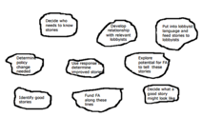
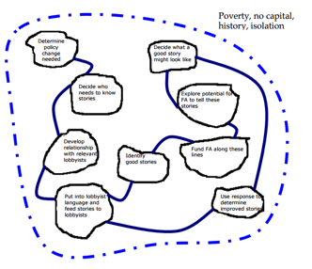
Soft system method
System properties:
o An ongoing purpose (that may be determined in advance – purposeful,
or assigned through observation - purposive)
o A means of assessing performance
o A decision taking process
o Components that are also systems (i.e., the notion of sub-systems)
o Components that interact
o An environment (with which the system may or may not interact)
o A boundary between the system and the environment (that may be closed or open)
o Resources
o Continuity
core relevant activities:
4.
Developing the model
Write down activities
Select the ones that should be done first
Place them in line where the independent once goes first
Indicate the dependencies
Rearrange to avoid overlapping
Check if your model demonstrated all system properties
http://www.bobwilliams.co.nz/Systems_Resources_files/ssm.pdf
Notes:
The fourth step is then to use your root definitions from last step and draw up a conceptual model. This you do in 6 steps: first write down all activities necessary to carry out the transformation. Then select the activities that can be made at once. Line them up so that the first independent activities are in a line and then follow with the others in a new line and so on. Continue by draw lines of the dependencies. Fifth step is to rearrange it so it makes sense with the earlier process like CATWOE. Finally you check if your system follows these properties. (show) I will not say it but you can read it later if you’re interested.
Important is to not spend to much time creating this model because it should still be open for discussion and changes

Slide 42
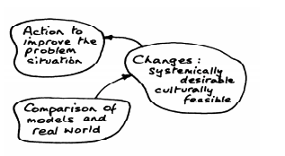
Soft system method
5.
Compare model and real world
1. Unstructured discussions
2. Structured questioning of the model using a matrix approach
3. Scenario or dynamic modelling
4. Trying to model the real world using the same structure as the conceptual model
So in the Sustainable Food Collaboration example we would look at the above model and the basis of that model (ie CATWOE and the root definition) and consider what actually does happen in the real world. What is present, and what is missing. What behaves similarly and what does not.
http://www.bobwilliams.co.nz/Systems_Resources_files/ssm.pdf
Notes:
Fith step is to compare the model and the real world.
The biggest and most common mistake you can make at this stage is to confuse reality with the model. A holon is a perspective on the system; it is a way in which some people might see the program. The purpose of this stage is to develop insights.
To compare the model and the real world you can use these steps; have unstructured discussions, structured questioning of the model using a matrix approach, do scenario or dynamin modelling and try to model the real world by using the same structure as the conceptual model.

Slide 43
Soft system method
6.
Develop desirable and feasible interventions
1. Run through the model again using different perspectives and scales
2. Undertake different systems based analyses
3. “Owner” analysis. Who fundamentally has the authority to take action ?
4. “Social system analysis” How do the various roles, norms and values present in the real world relate to the conceptual model ?
5. “Political analysis”. How is power expressed in the situation being studied ?
http://www.bobwilliams.co.nz/Systems_Resources_files/ssm.pdf
Notes:
Now the methodology stops being linear and allows for going back and forth in the steps.
checkland suggest following these steps: run through the model again using different perspectives, undertake different system based analyses, go back and see who has the authority to take action, compare how the real world norms, values and roles can relate to the model and at last to a political analysis and answer how the power expressed in the situation being studied.

Slide 44
Soft system method
7.
Take action to improve the situation
http://www.bobwilliams.co.nz/Systems_Resources_files/ssm.pdf
Notes:
Then you are finally at the last step nr 7 which is take action to improve the situation!

Slide 45
CONCLUSIONS

